Slide 1


Data Science Bootcamp
Baigal & Flaude
Notes:
12-03 12-21
12-23 12-36
13-00 13-13

Slide 2


Prédire la production & la consommation d’énergie

Slide 3
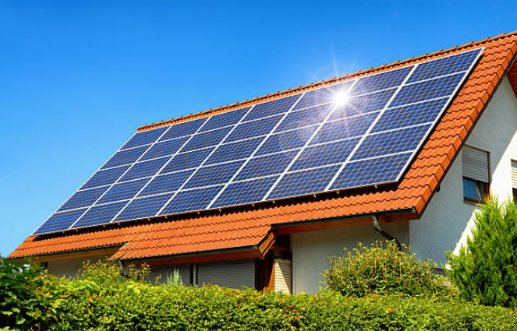
Objectif :
Construire un modèle de Machine Learning qui prédit la production et la consommation d’énergie d’une installation solaire.

Slide 4
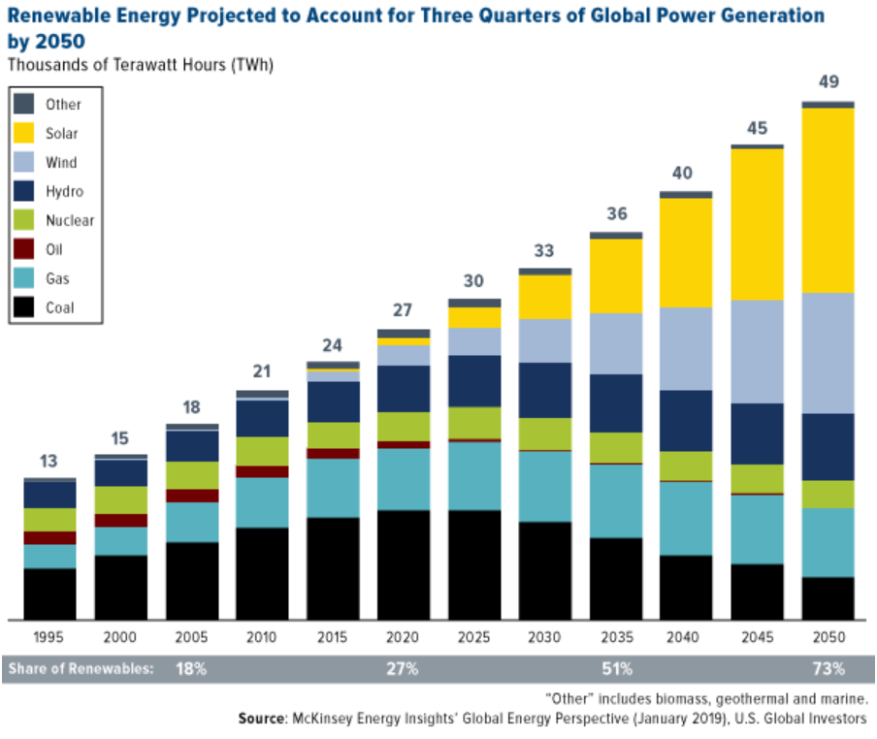
Contexte :
Transition énergétique.

Slide 5
Méthodologie adoptée:
Recherche les données
EDA
Modélisation
Feature selection
Résultats
Conclusions

Slide 6
Recherche les données

Slide 7

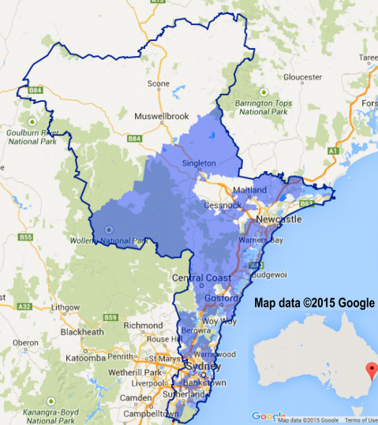

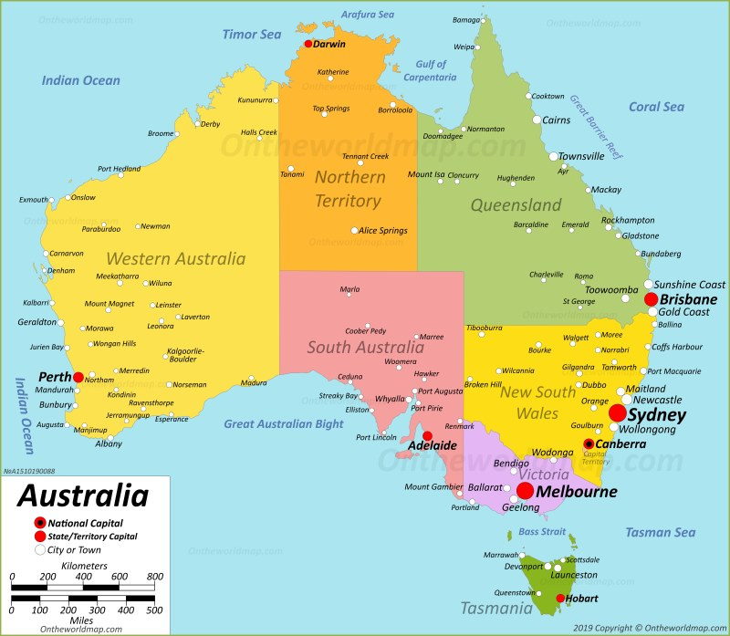
Les données
Les données de ce projet proviennent de l’API de Ausgrid et concernent 300 foyers équipés de systèmes solaires sur le toit.

Slide 8
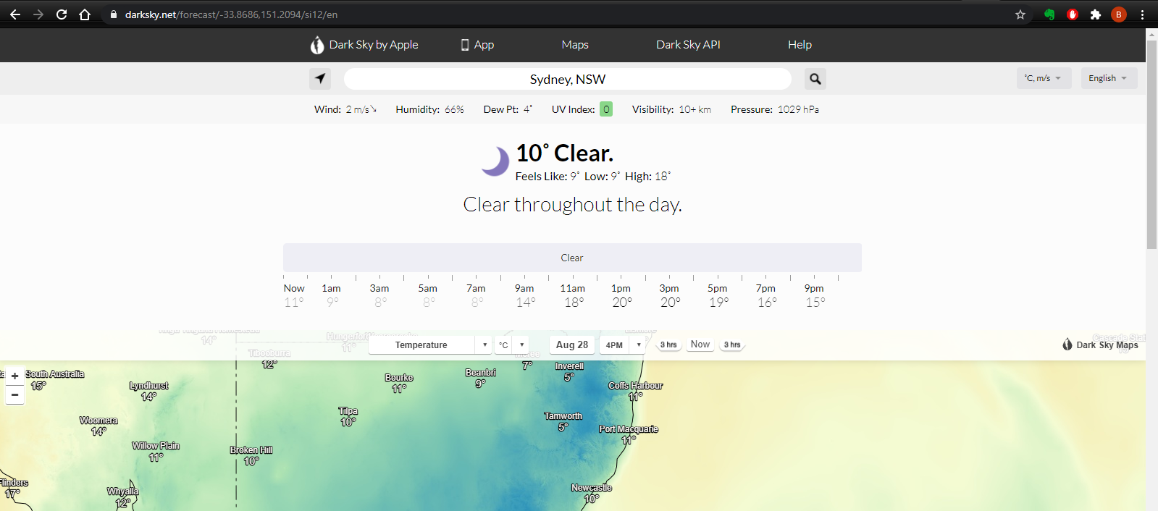
Pour les données météorologiques
Nous avons utilisé les informations météorologiques de DarkSky.net. Nous avons fait du web-scraping pour obtenir 3 ans de données météo, température, indice UV, neige.

Slide 9
Data overview
Location | Australia, East coast
Date | 2010-2013
Number of observations | 300 household (52602 observations)
Repeat | Every 30 mins
Target | Energy Consumption(GC)
Location | Australia, East coast
Date | 2010-2013
Number of observations | 300 household (52602 observations)
Repeat | Every 30 mins
Features | Temperature, Humidity,UV Index, Cloud Cover, Rain chance, Snow chance, Dew point, Pressure, Wind speed, Wind Gust, Wind Bearing, Visibility
Target | Energy Generation(GG)
Data for energy consumption
Data for energy generation

Slide 10
EDA

Slide 11
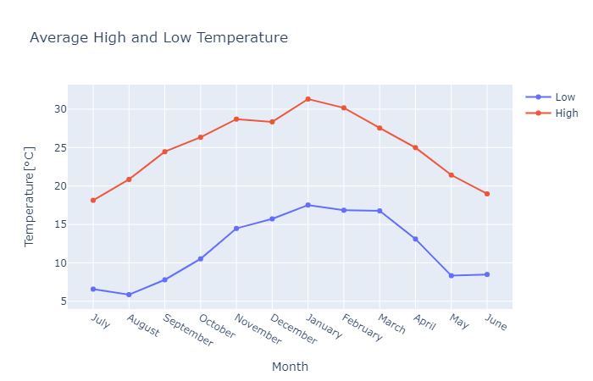
Average High and Low Temperature

Slide 12
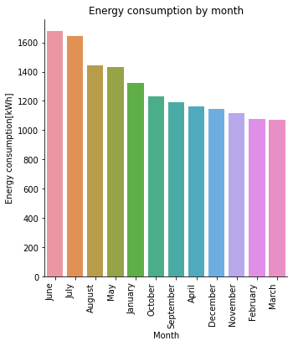
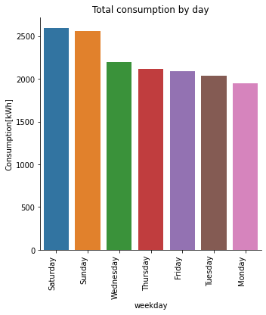
Energy consumption by month, by week

Slide 13
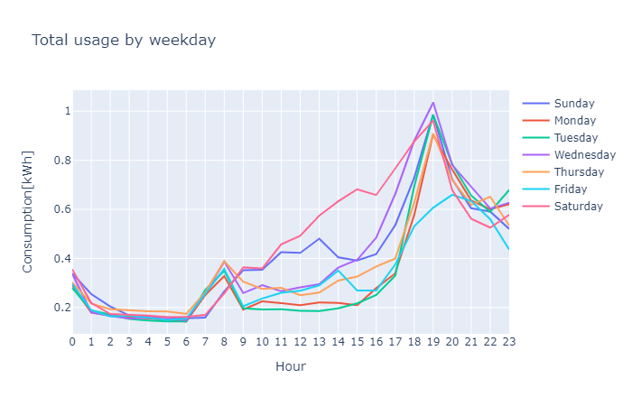
Energy consumption by week and weekend

Slide 14
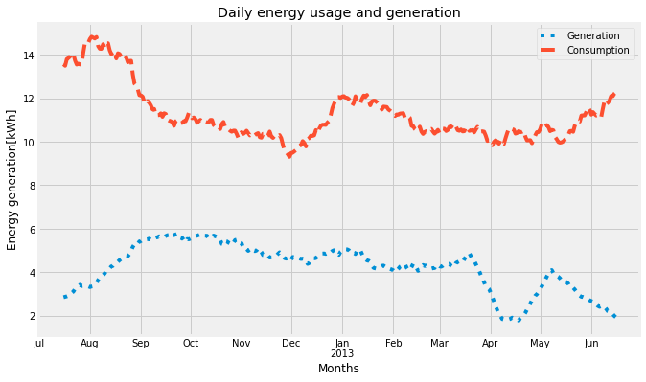
Daily energy generation and consumption

Slide 15
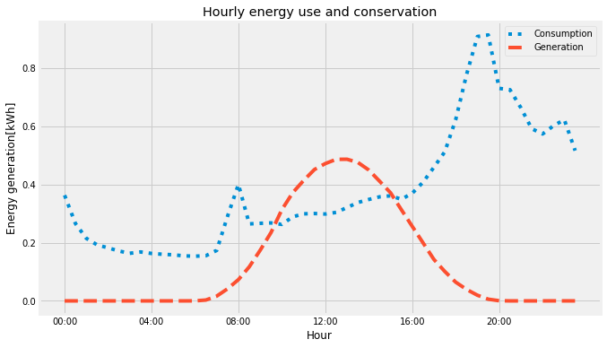
Energy generation and consumption hourly

Slide 16
Energy generation and features

Slide 17
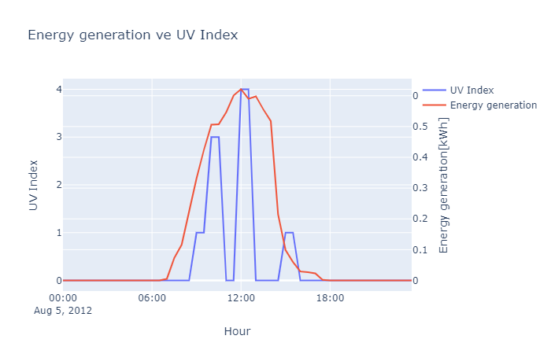
Energy generation vs UV Index

Slide 18
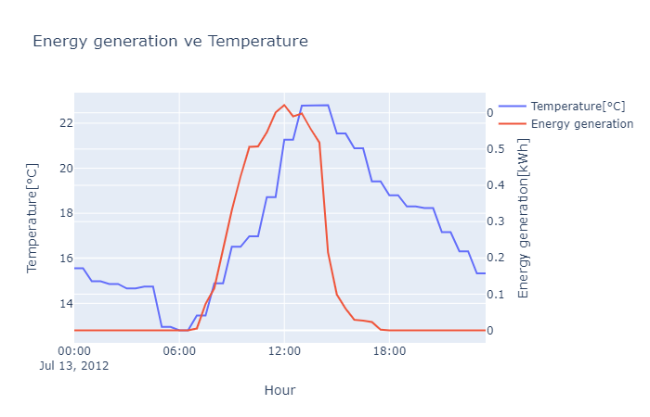
Energy generation vs Temperature

Slide 19
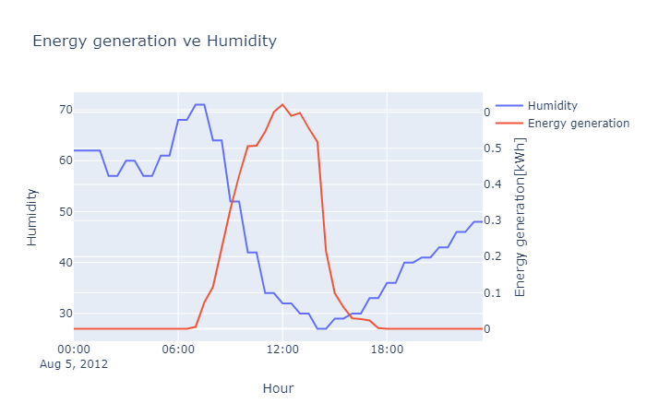
Energy generation vs Humidity

Slide 20
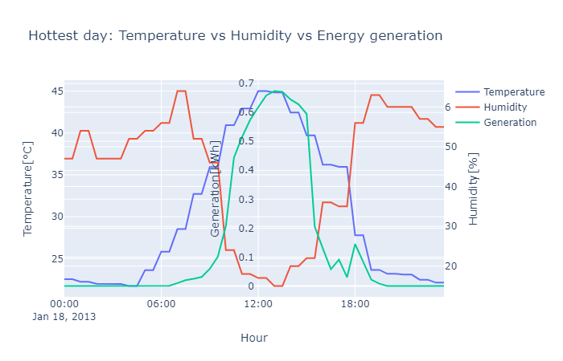
Temperature, humidity and generation

Slide 21
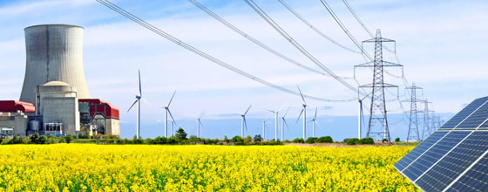
Modélisation sur la production d'énergie

Slide 22
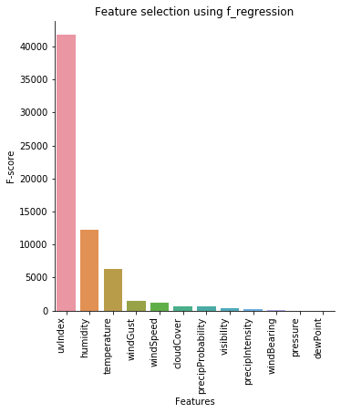
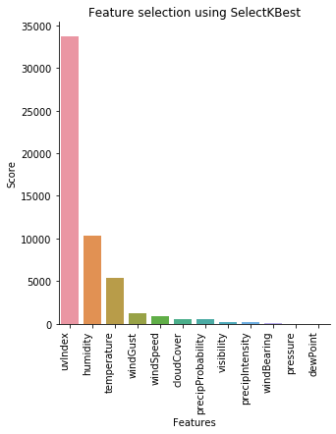
Feature selection
Most important feature (LR)
SelectKBest method

Slide 23
Modèles et Résultats
Model | Before Feature selection |  | After Feature selection
Score | R2 score | MSE | R2 score | MSE
Linear regression | 0.58 | 0.027 | 0.57 | 0.027
Random Forest | 0.75 | 0.016 | 0.69 | 0.019
XGBoost | 0.82 | 0.012 | 0.72 | 0.018

Slide 24

Modélisation sur la consommation d'énergie
source

Slide 25
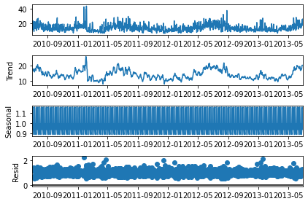
Forecasting Time series
Why time series is special?
Level,Trend,Seasonality,Noise, Stationarity
4 models used
ARIMA
SARIMAX
LSTM (deep learning)
Facebook’s Prophet
ARIMA model

Slide 26
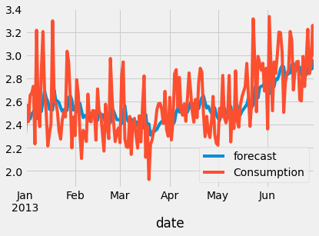
ARIMA modeling
Find best parameters: auto_arima (functions as GridSeachCV)
AR:p Auto-regressive aspect of the model, which incorporates past values.
Integrate:d Integrated part of the model. Effect the amount of differencing to apply to a time series
MA:q Moving average part of the model
Model gets the trend and level. But not much accurate in terms of highest and lowest points.
Prediction vs actual consumption

Slide 27
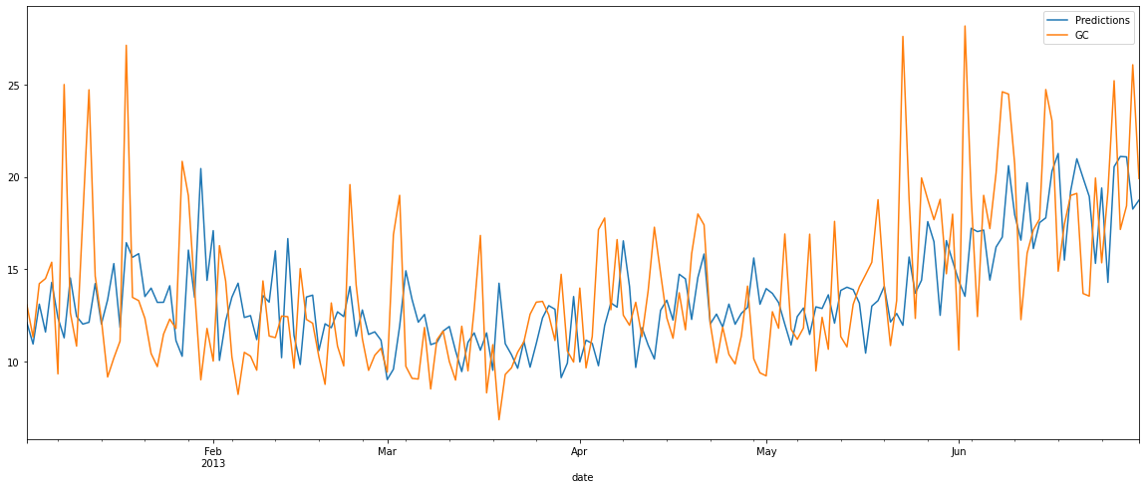
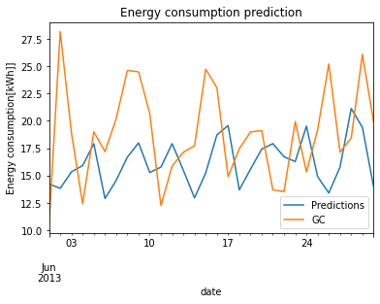
SARIMAX model
ARIMA model with SEASONALITY
Train set
Test set (prediction)

Slide 28
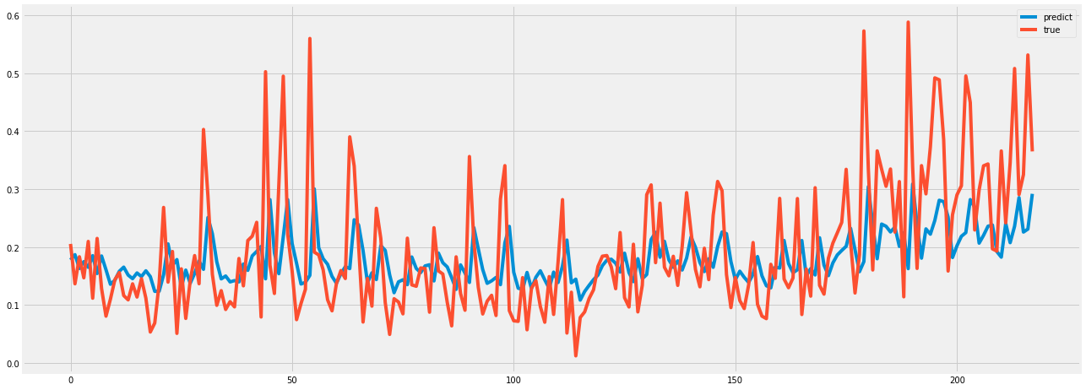
Naive LSTM model
Most simple LSTM model with 2 layers(input 100), 1 Dense layer (output 1), loss function:mae, optimizer:adam.
Result in test set

Slide 29
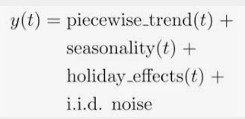
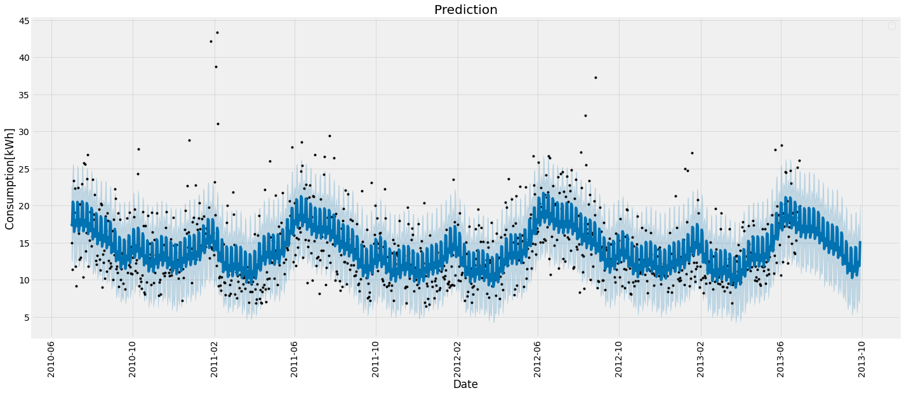
Facebook Prophet
Prediction

Slide 30
Modèles et Résultats
Modèle | RMSE[kWh]
ARIMA | 5.4
SARIMAX | 4.1
LSTM | 3.8
Prophet | 5.5

Slide 31
Conclusion & Perspectives

Slide 32
Conclusion
Obtenir plus de données pour mieux faire nos prédictions
La radiation(UV Index), la température et l’humidité semblent être des paramètres importants pour mieux générer de l’énergie solaire
Pour la production d'énergie, le modèle XGBoost fonctionne le mieux (score de 0,82 R2)
Pour la consommation d'énergie, le modèle LSTM fonctionne le mieux (3,8 [kWh] RMSE).

Slide 33
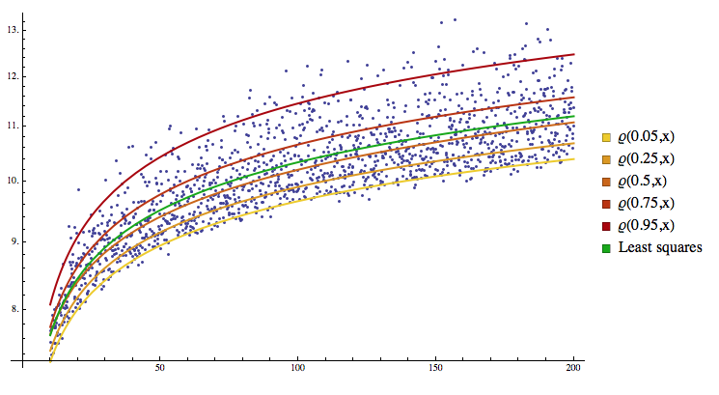
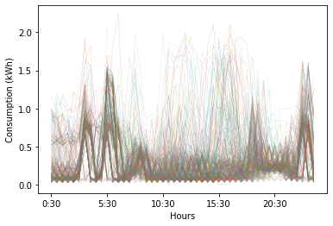
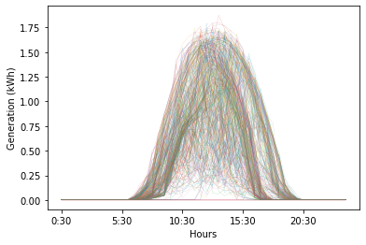
Perspectives
Use quantile regression K-near neighbors method to find 300 household energy consumption and generation
Feature selection for energy consumption prediction

Slide 34
Merci pour votre aimable attention ! Merci Jedha et tous les profs!!
Question(s) ?

Slide 36
Pour les questions, si il y a.

Slide 37
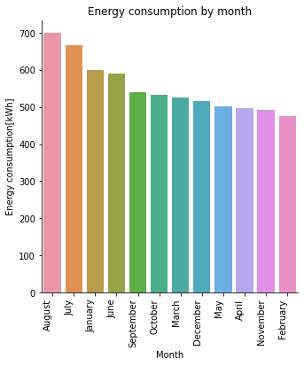
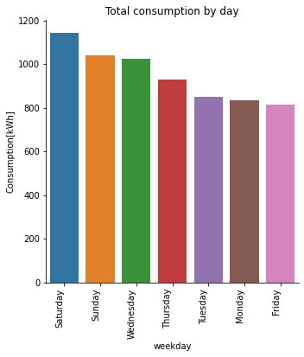
Energy consumption by month, by week

Slide 38
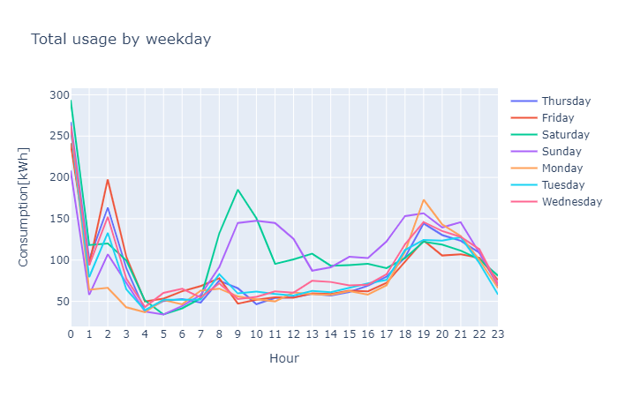
Energy consumption by week and weekend

Slide 39
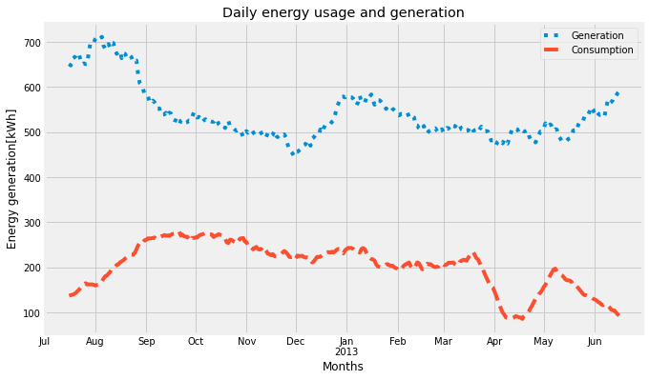
Daily energy generation and consumption

Slide 40

Project idea
Future of energy:
The world is in a transition to new kinds of energy:
Blockchain enabled software platform for trading renewable energy and environmental commodities.
“Energy independence is new independence.”
The peer-to-peer nature of blockchain could provide a particularly useful answer to the existing problems we see within energy networks around the world.
Image source

Slide 41
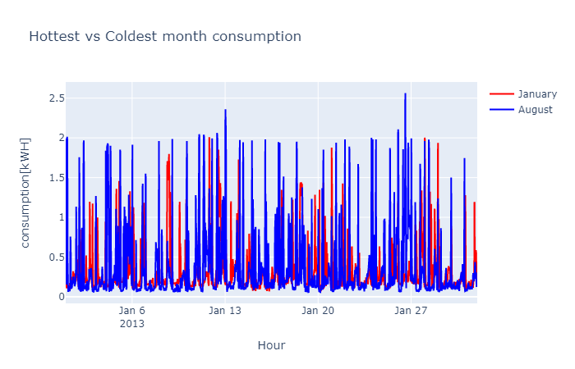
Hottest vs Coldest month consumption

Slide 42
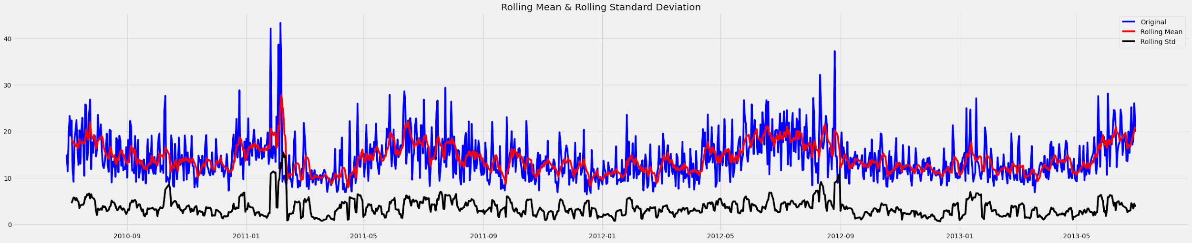
ARIMA model
Important parameters:
AR:p Auto-regressive aspect of the model, which incorporates past values.
Integrate:d Integrated part of the model. Effect the amount of differencing to apply to a time series
MA:q Moving average part of the model

Slide 43
Forecasting Time series
Why time series is special?
Level: The baseline
Trend: Behavior of the series over time.
Seasonality: Repeating patterns or cycles of behavior over time.
Noise: Variability in the observations
Stationarity: A time series is stationary when the mean, variance, and autocorrelation are constant over time
ARIMA model

Slide 44
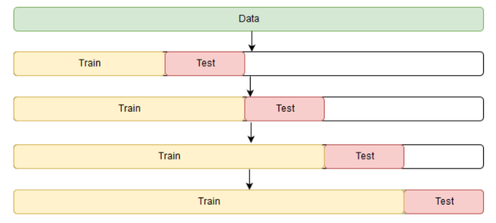
ARIMA model
Find best parameters: auto_arima (GridSeachCV in arima)
Window rolling technic

Slide 45
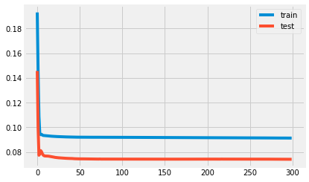
Naive LSTM model
Most simple LSTM model with 2 layers(input 100), 1 Dense layer (output 1), loss function:mae, optimizer:adam.
Loss in train, test set

Slide 46
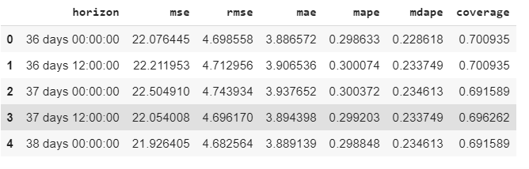
Facebook Prophet
We can see more detail in Prophet result!
Prophet result

Slide 47
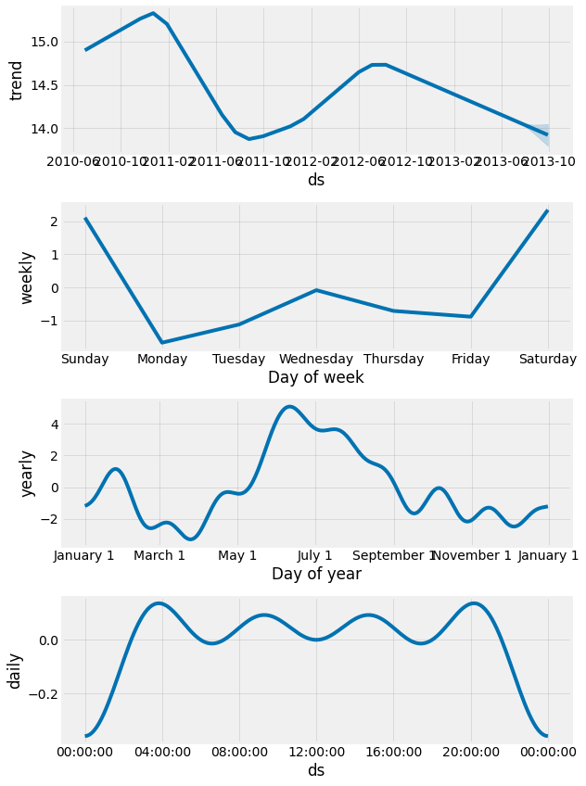
Facebook Prophet
Prophet uses models trend, seasonality and HOLIDAY effects, and irreducible error.
Prophet
Decomposition

